Slide 1
COMP5434 Big Data Computing
Zhang Chen，Jason
Department of Computing (COMP)

Slide 2
Basic Information
yanjie3.sun@connect.polyu.hk>
Instructor: Zhang Chen
- E-Mail: jason-c.zhang@polyu.edu.hk
Include [COMP5434] in your subject.
- Office: PQ711
Lectures: 18:30 to 21:20 every Monday (every 50 mins +10mins break)
Office Hour: Every Monday 15:00 – 17:00 or by email appointment.
Our TAs:
- Li Huahang hua-hang.li@connect.polyu.hk,
- Sun Yanjie yanjie3.sun@connect.polyu.hk,
- Hu Wentao wayne-wt.hu@connect.polyu.hk
Slides shared by Jieming Shi, Hongcheng Xie,Yang Veronica Liu, modified by Zhang Chen

Slide 3
About our online platform
Learning Platform (Blackboard): https://learn.polyu.edu.hk
Please check Blackboard REGULARLY!
- Announcements
- Lecture slides
- Assignments
- Project
- …
p.s.: Please also check our mailbox REGULARLY!

Slide 4
Learning Objectives
- understand the concept and challenge of big data
- understand how to manage, store, and query various form of big data
- familiar with the classical data analysis and machine learning algorithms
- familiar with large-scale analytics tools to solve some open big data problems
- analyze the impact of big data for real-world applications

Slide 5
Assessments
- 2 Written Assignments (15%)
- 1 Final Project (15%)
- Code, Report and Presentation
- 3 or 4 students per group
- 1 Final Exam (70%)

Slide 6
Grading Policy
Late Policy of Assignments and Project
- Late [0h, 24h): 20% reduction
- Late [24h, 48h): 40% reduction
- Late [48h, +∞): 100% reduction
No plagiarism on all assessments.

Slide 7
Tentative Schedule
Week | Topic | Tutorials / Assignments
1 | Introduction to Big Data
2 | Classic Data Analytics I
3 | Classic Data Analytics II | Tutorial on Jupyter and Python; Assignment 1 release
4 | Hadoop and MapReduce | Tutorial on Hadoop
5 | HDFS and Spark
6 | Neural Networks | Final Project Release
7 | Graph Analytics
8 | Big Data Storage | Tutorial on PyTorch
9 | More on Data Analytics | Assignment 2 release
10 | Visualization
11 | Cloud Computing & Revision
12 | Project Presentations
13 | Project Presentations

Slide 8
Outlines
Part I: Introduction
- What Drives Big Data
- Characteristics of Big Data
- Technology Towards Big Data
Part II: Basic Big Data Concepts
- Data Concepts/Models
- Big Data Process
- Data Analytics

Slide 9

What is Data
What is data?
- facts and statistics collected together for reference or analysis.
- If something can be measured, observed, or described, it can be converted into a digital format.
“Imagine data as a Mirror. Data isn't just numbers and facts; it's the imperfect, scattered, and powerful reflection of the world around us. Its value lies not in the fragments themselves, but in the knowledge we gain when we put the mirror back together.”
What is Not data?
- Can everything become data?
the feeling of happiness
taste of a banana
an idea
------ Google Gemini 2.5

Slide 10
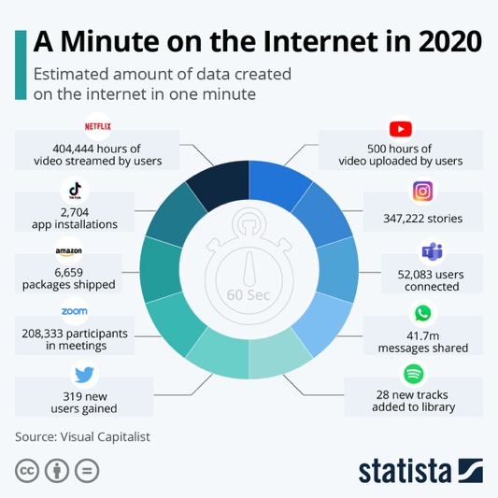
The Era of Data
Posts to social media sites
Digital pictures and videos
Software logs, cameras
Microphones
Sensing data
Scans of government documents
GPS trails
Purchase transaction records
Cell phone GPS signals
Traffic
...

Slide 11
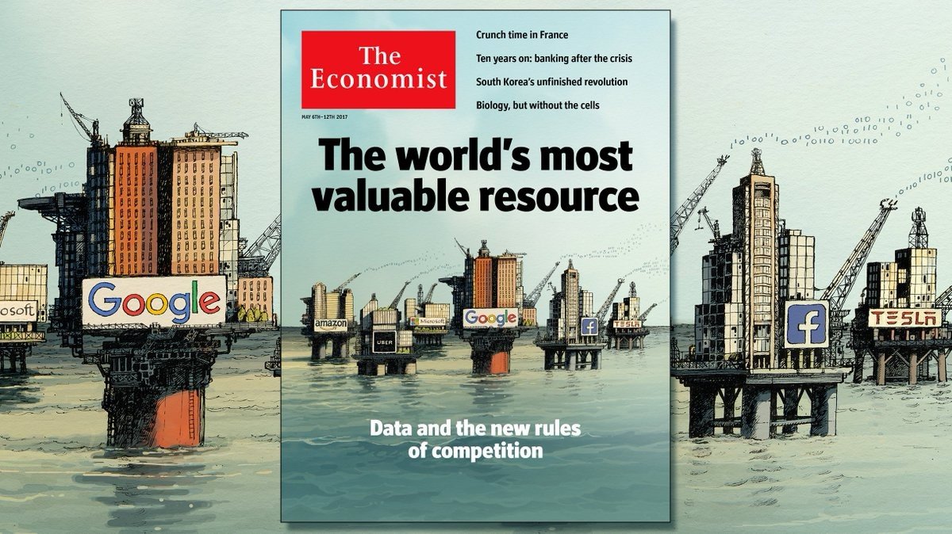
Data is the New Oil

Slide 12
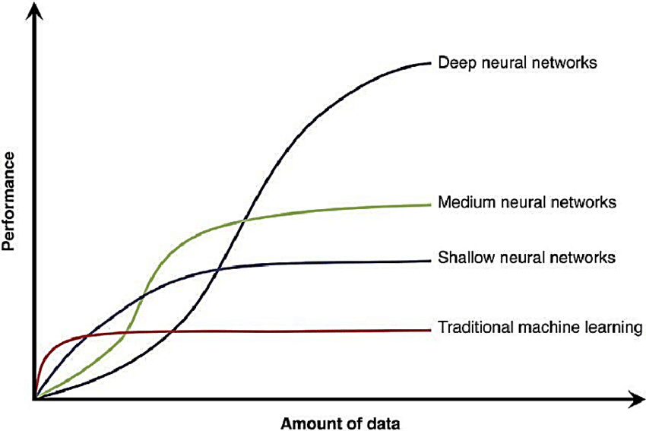
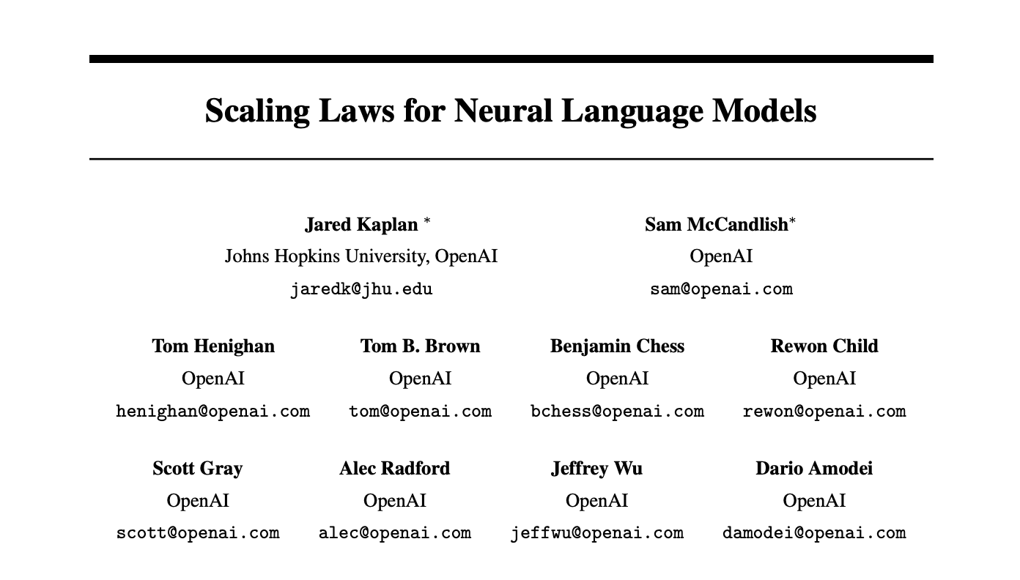
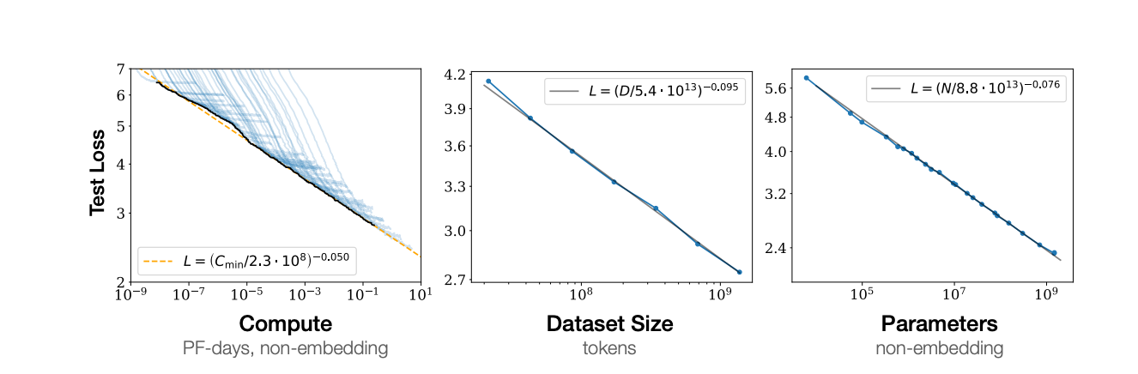
Data Drives Artificial Intelligence
The groundbreaking discovery of “Scaling Law”
published on arXiv in January 2020

Slide 13
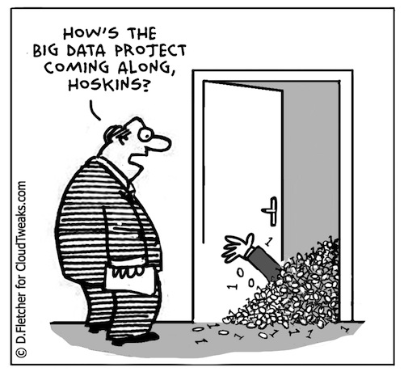

Why “Big”?
"Big" Describes a Problem
“Big Data”
--->
“Large Model”
Why not “Large Data”?
Big Data: Big Problems?

Slide 14
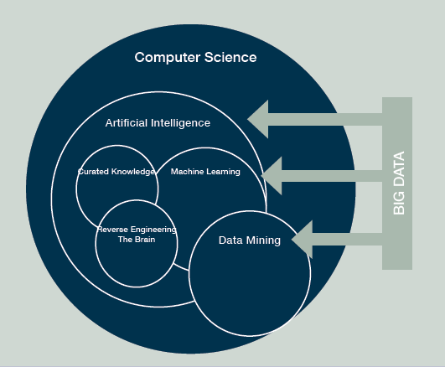
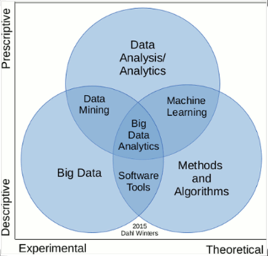
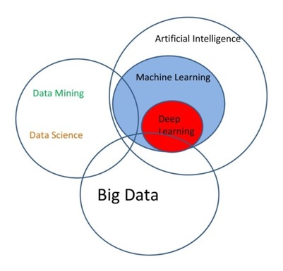
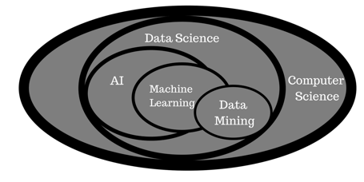
Multidisciplinary Research

Slide 15
Outlines
Part I: Introduction
- What Drives Big Data
- Characteristics of Big Data
- Technology Towards Big Data
Part II: Basic Big Data Concepts
- Data Concepts/Models
- Big Data Process
- Data Analytics

Slide 16
Why Big Data?
Optimizations and predictive analytics
Complex statistical analysis
All types of data, and many sources
Very large datasets
More of a real-time
Ad-hoc querying and reporting
Data mining techniques
Structured data, typical sources
Small to mid-size datasets

Slide 17
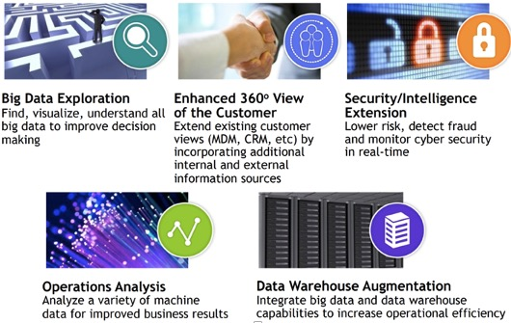
Application Categories

Slide 18
Customer Analysis
“How Big Data Is Used In Amazon Recommendation Systems” https://www.youtube.com/watch?v=S4RL6prqtGQ

Slide 19
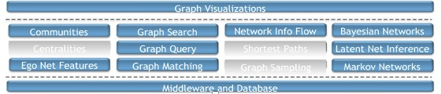
Security

Slide 20
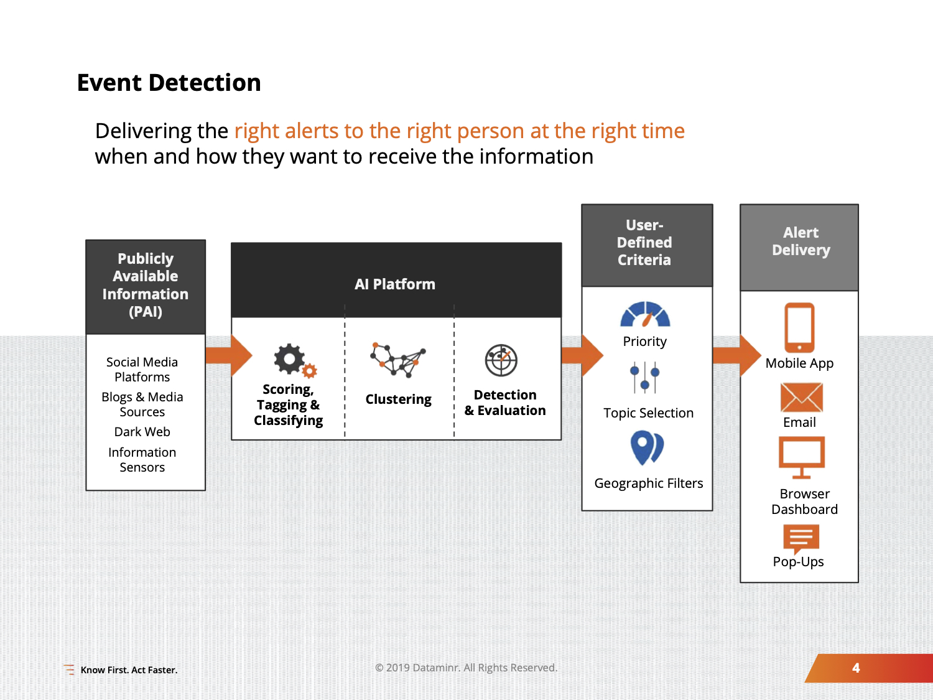
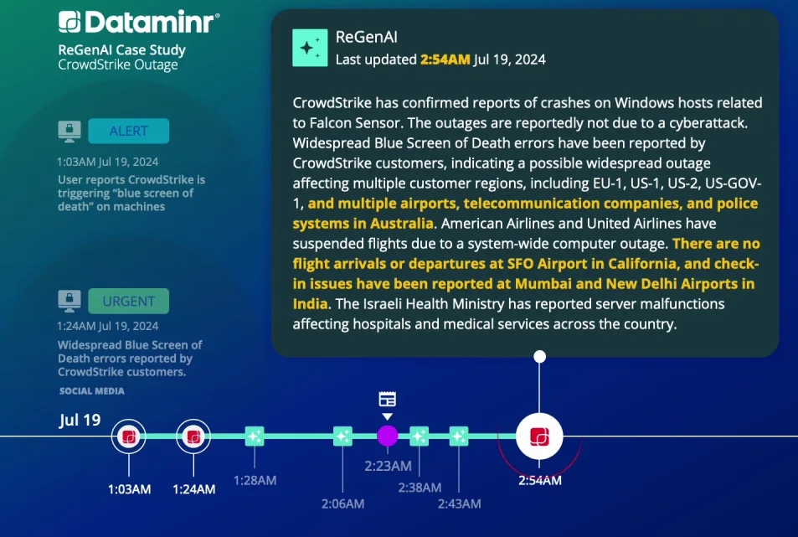
Real-time Information Discovery
High volume/velocity: billions of public data inputs per day
low latency : AI models on each inputs in 7.8 milliseconds
The AI Firm Turning 1M Real-Time Data Sources Into Actionable Intelligence

Slide 21
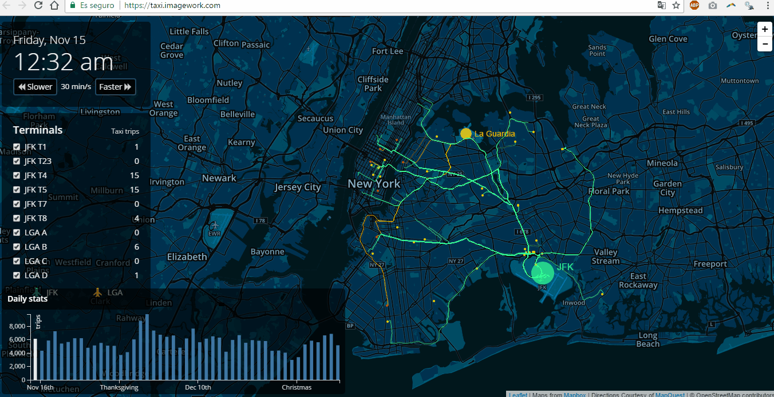
Transportation
Taxi trajectories in New York City from Nov 15th to December 31st, in 2013

Slide 22
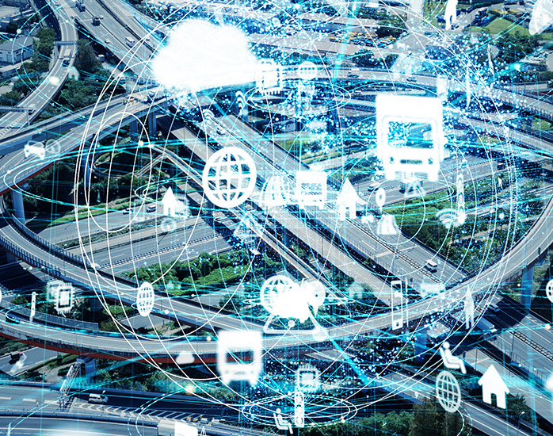
Transportation
We can observe the traffic patterns with such kind of data, like,
- which road is more likely to be congested
Improve the city mobility
- help design a better traffic light plan
- find out the road with the heaviest traffic
- guide the design of new bus route or a new metro line

Slide 23
AlphaGo
AlphaGo learns from 30 million moves of 160 thousands games played by experts (5-9 dan) → Big Data
AlphaGo uses deep learning and neural networks combined with Monte-Carlo tree search to decide the moves → Analytics

Slide 24
AlphaGo

Slide 25
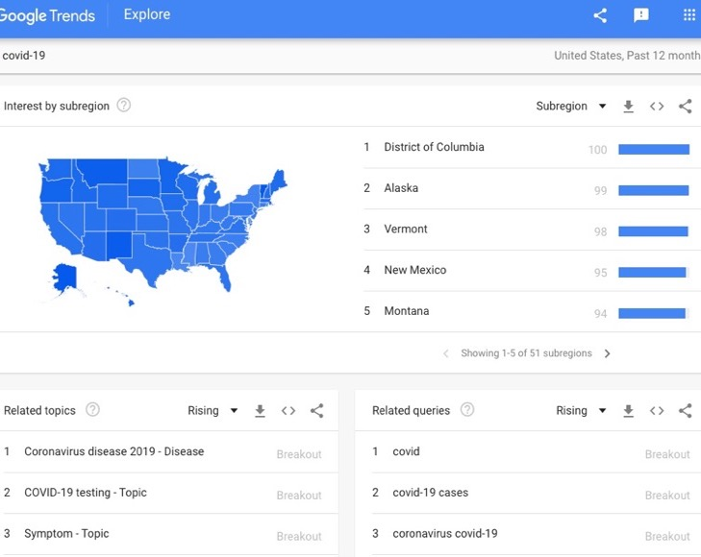
Pandemic Analysis
https://www.youtube.com/watch?v=vJTHNobkh18

Slide 26
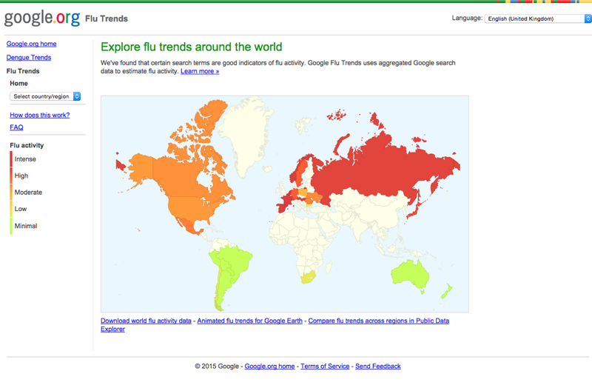
Pandemic Analysis

Slide 27
Google Flu Trend
Google Flu Trends (GFT) was once held-up as the prototypical example of the power of big data.
A group of Data Scientists with little relevant expertise were able to predict the spread of flu across the continental United States.
More accurate than the “experts” at the Centre for Disease Control with their models built from expensive survey data.

Slide 28
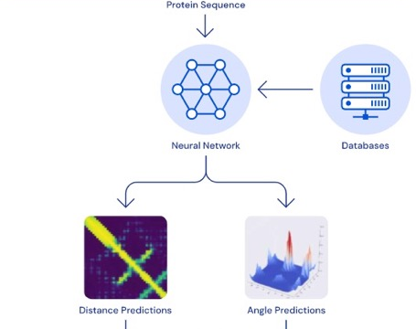
AlphaFold
To predict new protein structures that we haven’t found.
Custom-built Big Fantastic Database (BFD) of 65,983,866 protein families, covering 2 Billion protein sequences.
“AlphaFold: The making of a scientific breakthrough”
https://www.youtube.com/watch?v=gg7WjuFs8F4

Slide 29
Disease Treatment
Disease Treatment: Joint research between Google DeepMind and Moorfields Eye Hospital.
Eyecare professionals diagnose eye conditions by using optical coherence tomography (OCT) scans (over 1,000 a day at Moorfields alone)
Achieving expert error rate 5.5% comparably to the two best retina specialists (6.7% and 6.8% error rate)

Slide 30
Precision Medicine

Slide 31

CityBrain
Developed by Alibaba Group.
CityBrain systems have been adopted in Kuala Lumpur, the capital of Malaysia.

Slide 32
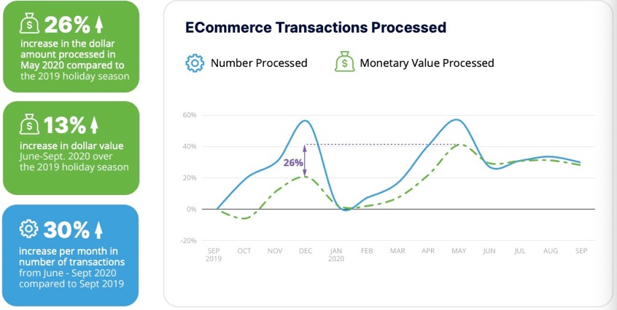
FinTech
https://feedzai.com/wp-content/uploads/2020/11/Feedzai-QuarterlyReport-Q42020.pdf

Slide 33
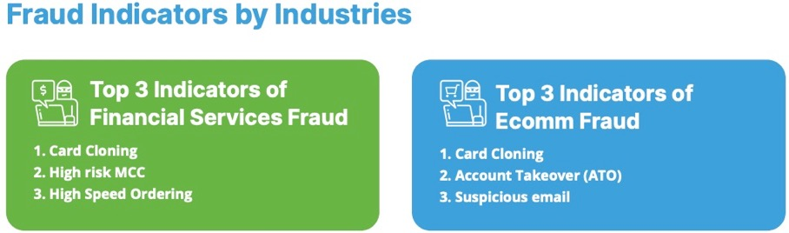
FinTech
Detect insurance fraud
Validate account opening
Outlier detection
Detect anti-money laundering
Graph mining
Monitor transaction fraud
Classification
https://www.youtube.com/watch?v=fmjhpumzwOw

Slide 34
More Big Data Applications
1. Personalized Search
2. Recommendation
3. Commerce
4. Financial Analysis
5. Social Media Monitoring
6. Customer Analysis
7. Healthcare Analysis
8. Data Visualization
9. Near Earth Object Analysis
10. Anomaly Detection
11. Fraud Detection
12. Cybersecurity
13. Sensor Monitoring
14. Cellular Network Monitoring
15. Cloud Monitoring
16. Code Life Cycle Management
17. Traffic Navigation
18. Video Semantic Understanding
19. Genomic Medicine
20. Brain Network Analysis
21. …

Slide 35
Outlines
Part I: Introduction
- What Drives Big Data
- Characteristics of Big Data
- Technology Towards Big Data
Part II: Basic Big Data Concepts
- Data Concepts/Models
- Big Data Process
- Data Analytics

Slide 36
What is Big Data
Definition from Wikipedia:
“Big data” is a field that treats ways to analyze, systematically extract information from, or deal with data sets that are too large or complex to be dealt with by traditional data-processing application software.
The challenges include capturing data, data storage, data analysis, search, sharing, transfer, visualization, querying, updating, information privacy and data source.
Tends to refer to the use of predictive analytics, user behavior analytics, or certain other advanced data analytics methods that extract value from data.

Slide 37

What is Big Data
A dataset is "big data" when its size, speed, and complexity overwhelm the tools you are currently using to manage and analyze it.
The threshold for what is considered "big" is always moving as technology advances.

Slide 38
Characterization of Big Data
“Big data is high-volume, high-velocity and high-variety information assets that demand cost-effective, innovative forms of information processing for enhanced insight and decision making.” -- Gartner

Slide 39
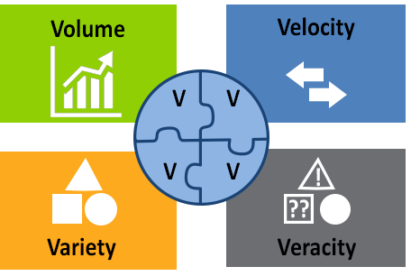
4V’s of Big Data
Volume
Velocity
Variety
Veracity

Slide 40
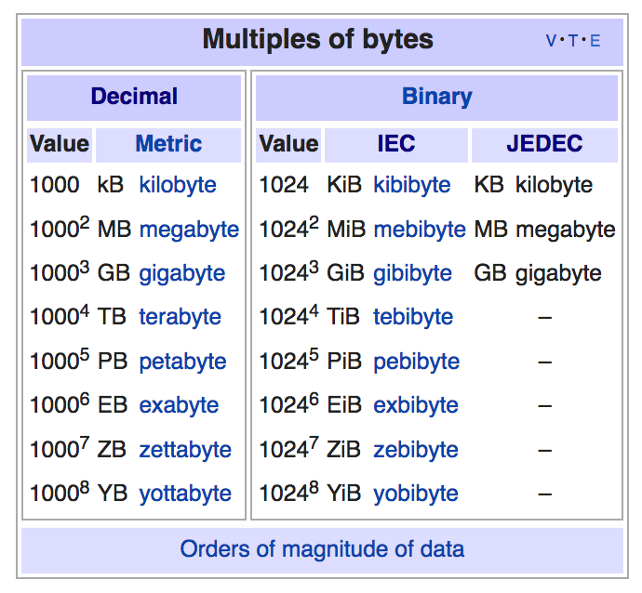
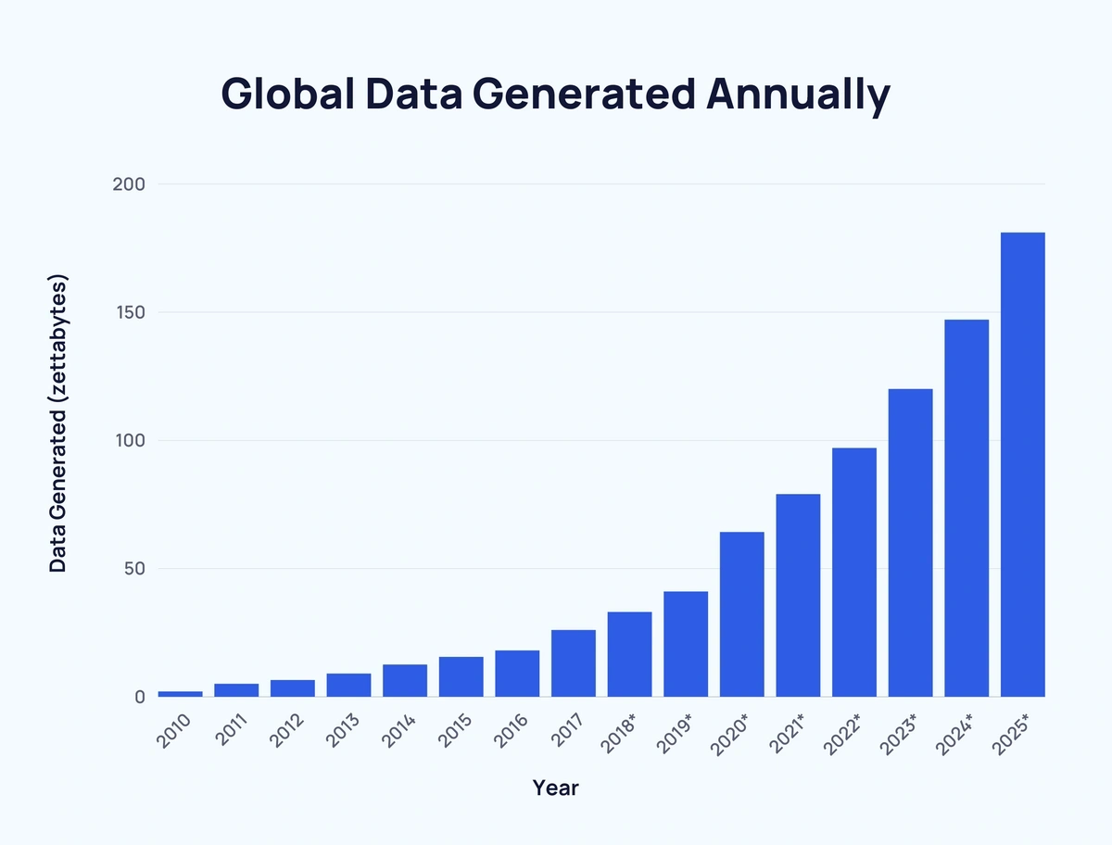
Volume: amount of data

Slide 41
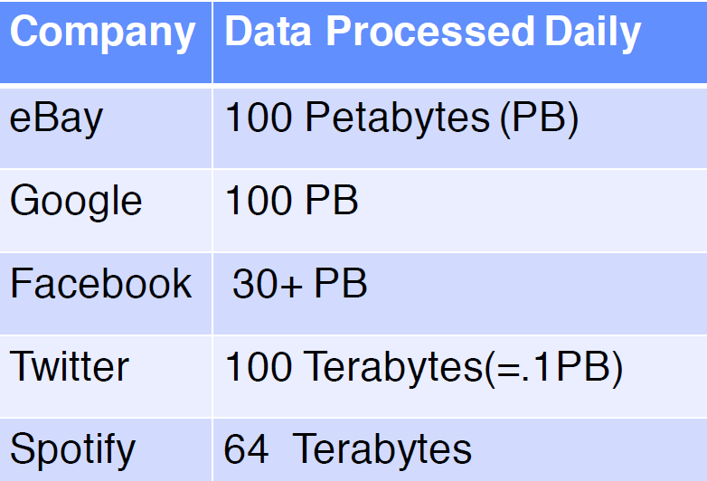




Volume: amount of data

Slide 42
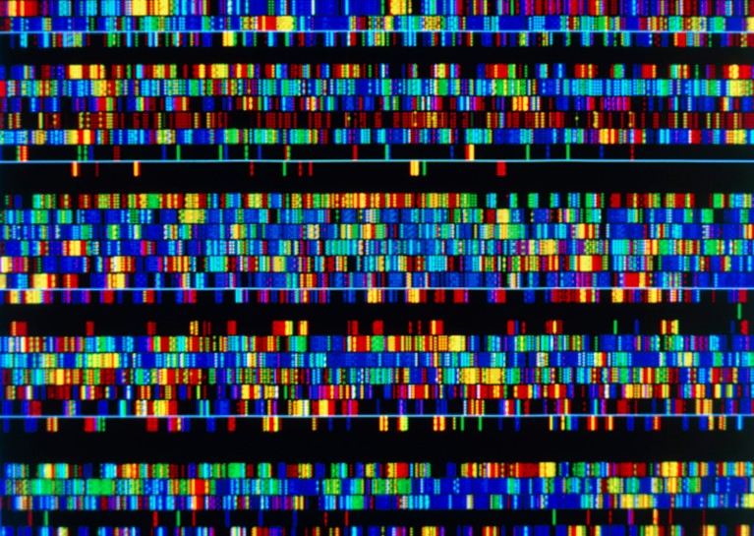
Volume: amount of data
Generated by huge number of devices and sensors
- 5 billion people have mobile phones
- A modern car has 100 sensors
- CERN's Large Hadron Collider (LHC) generates 1 petabyte of data/second.
A single human genome is equivalent to about 100 gigabytes. To print that data out would fill a stack of books 600 feet high—about half the height of the Empire State Building.
To store one year's worth of data from the LHC on standard CD-ROMs, the stack of CDs would be over 100 times the height of Mount Everest.

Slide 43
Velocity: speed of data generation

Slide 44
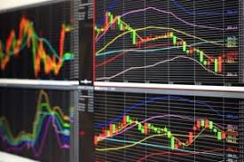
Velocity: speed of data generation

Slide 45
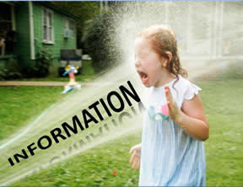
Velocity: speed of data generation
Data need to be processed fast
Online Data Analytics: late decisions mean missing opportunities
e.g. 1: Based on your current location and your purchase history, send promotions right now for store next to you.
e.g. 2: Sensors monitoring your activities and body, notify you if there are abnormal measurements.
e.g. 3: Detect money laundry in banking networks.

Slide 46
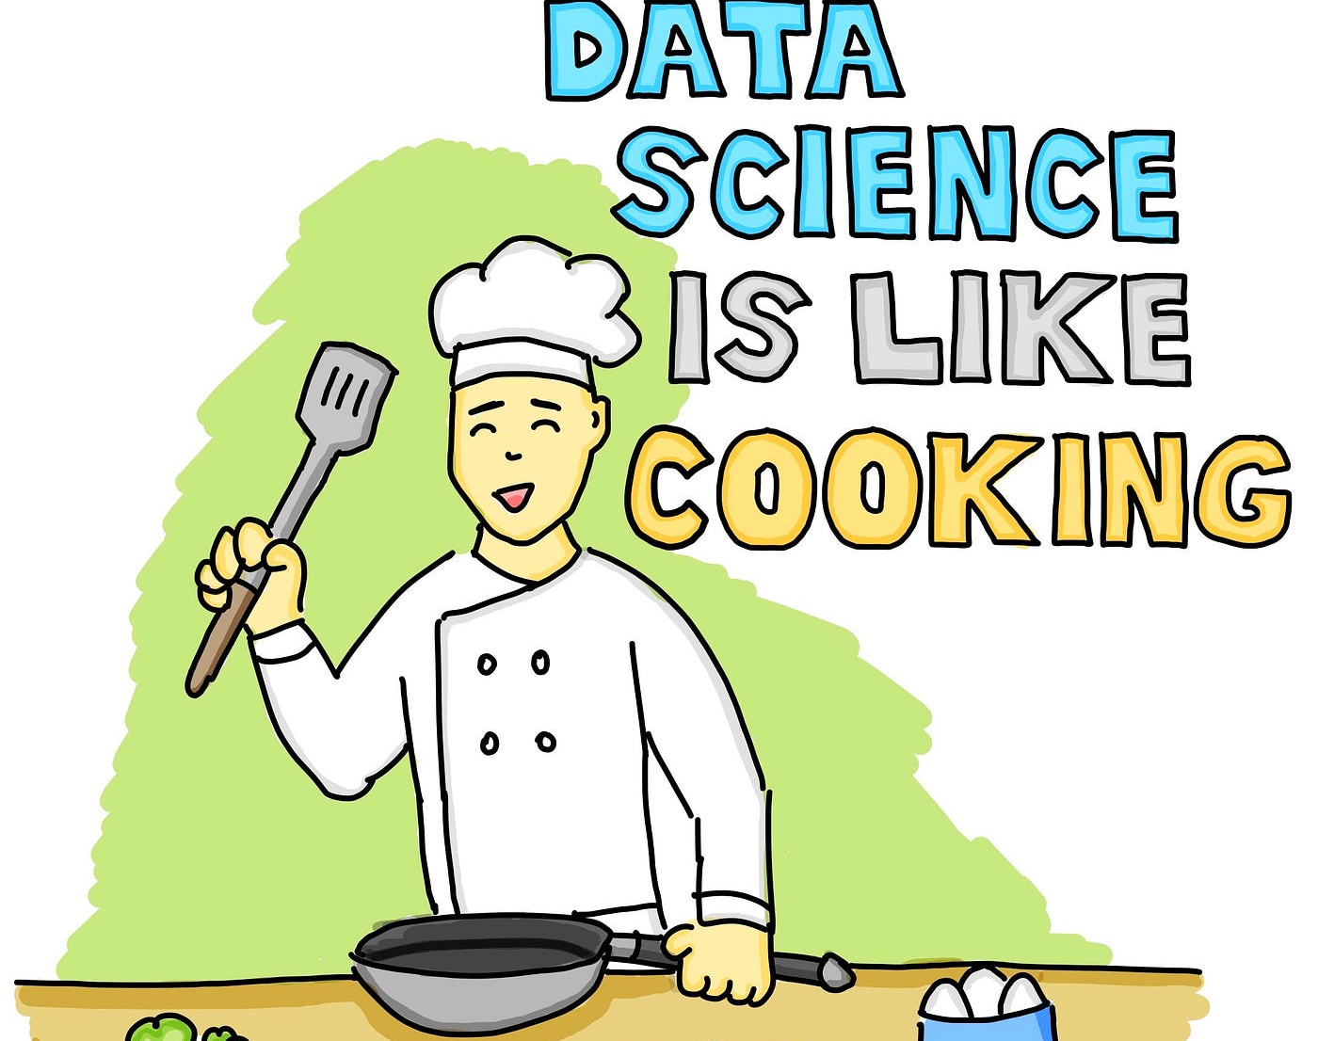
Variety: number of data types
A single application may generate/collect many types of data, e.g., types of data are stored in emails
Tabular data
Text (in email body)
Image (in attachment)
Hyperlinks (Web graph)
Data models
Relational Data (e.g., Tables)
Text Data (e.g., comments)
Semi-structured Data (e.g., XML)
Graph Data (e.g., social network)

Slide 47
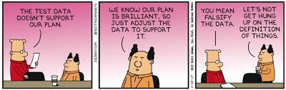
Veracity: uncertainty of data
Is the data accurate?
Measurement error
Human errors like typos in names/addresses
Does the data come from a reliable source?
What if data from different sources are not consistent?

Slide 48
Outlines
Part I: Introduction
- What Drives Big Data
- Characteristics of Big Data
- Technology Towards Big Data
Part II: Basic Big Data Concepts
- Data Concepts/Models
- Big Data Process
- Data Analytics

Slide 49
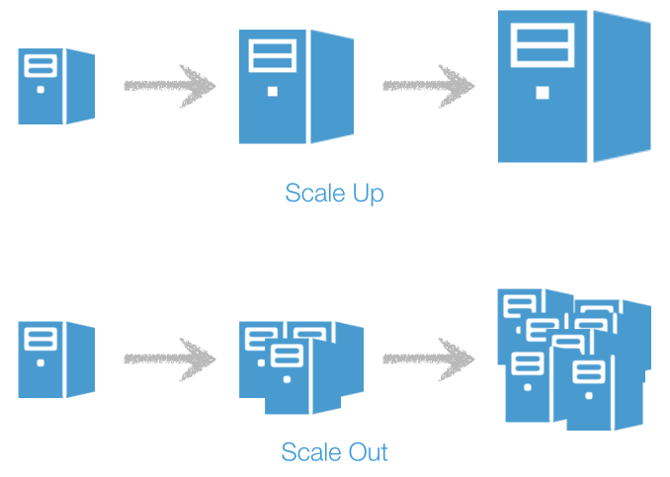
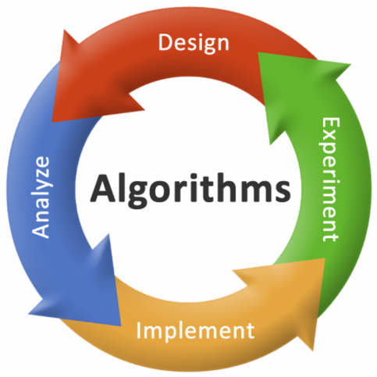
High-level strategies
Scale up
Scale out
Better algorithms
Efficiency
Effectiveness

Slide 50
Techniques towards Big Data
Massive Parallelism
Huge Data Volumes Storage
High-Speed Networks
High-Performance Computing
Task and Thread Management
Data Mining and Analytics
Data Retrieval
Machine Learning
Data Visualization
…

Slide 51
How to Solve the “Big” Problem
Applications
FinTech, Smart City, Bioinformatics, Social Media, Tourism, Transportation, ……
Data analytics
Clustering, Community detection, Association rules, Classification, Neural Networks, Graph algorithms …
Computational infrastructures
Hadoop, MapReduce, Spark, Hive, RDBMS, KV database, Graph database, …
Data
Images, text documents, social networks, spatial data (GPS), time series data, transaction networks, gene networks, …

Slide 52
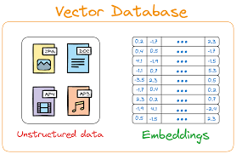
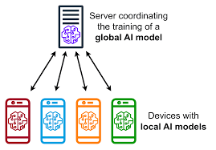
Recent Trends in Big Data Technology
Vector Databases and Search
-store and search for "embeddings”, numerical representations of unstructured data like text, images, and video.
-enable applications like Retrieval-Augmented Generation (RAG) to improve the output of Large Language Models (LLMs).
Synthetic data generation
AI-powered analytics and agentic workflow
Data democratization and privacy-preservation
Federated Learning
Federated Learning

Slide 53
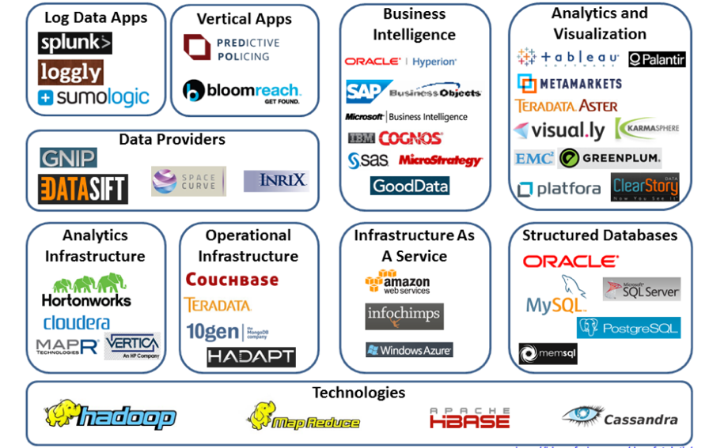
Big Data Landscape

Slide 54
Outlines
Part I: Introduction
- What Drives Big Data
- Characteristics of Big Data
- Technology Towards Big Data
Part II: Basic Big Data Concepts
- Data Concepts/Models
- Big Data Process
- Data Analytics

Slide 55
Attribute Types
Data
Quantitative
Qualitative
Numerical
Categorical
Do not have any meaningful order
Values have a meaningful order
Ordinal
Grade: A, B, C Timestamps
Nominal
Hair color: black, Brown, Blue
Have only 2 states
Exercises:
Whether a person is an official or not.
Race
Values in transactions
Binary
0(Absent) / 1(Present) True/False

Slide 56
Data Models
Relational
Text
Graph
Images, videos
Audio
Spatial data
xml
JSON
…

Slide 57
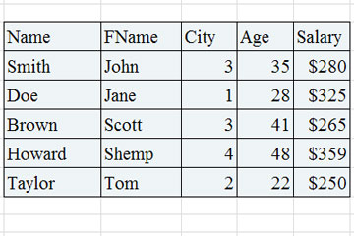
Relational Data
Relational databases, Table, Excel, CSV(Comma Separated Values)
An attribute/feature
An instance
/ a tuple / a record
Support fast, transactional, and precise retrieval of specific, related information.

Slide 58


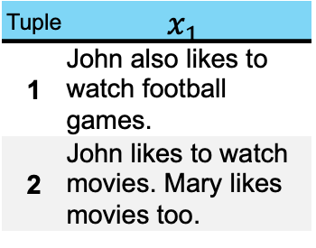
Text Data
Text
Short sentences
Corpus
…
Text analytics
Similarity
Sentiment
Search and retrieval
NLP
…
John likes to watch movies. Mary likes movies too.
Tuple | $$x_{1}$$
1 | John also likes to watch football games.
2 | John likes to watch movies. Mary likes movies too.
The internet is a gigantic, pre-existing library of human knowledge in the form of text.
Highly compressed and explicit form of knowledge.
- A single high-resolution image contains millions of data points (pixels). A 100-word paragraph is only a few hundred tokens.

Slide 59

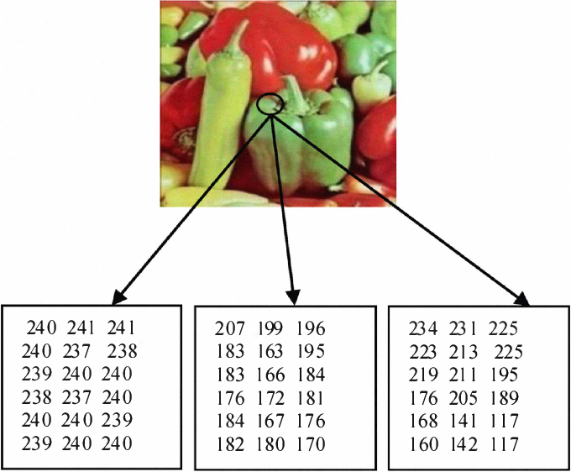
Image/Video Data
Grey and RGB images
Object detection
Image segmentation
Handwriting recognition
…
125 | 200 | 225
105 | 150 | 255
15 | 75 | 175
https://en.wikipedia.org/wiki/MNIST_database
Type of Image | Data Structure | Example
Grayscale | A 2D array of numbers | [[100, 150, 200], [210, 50, 120], ...]
Color (RGB) | A 3D array of numbers | [[[R,G,B], [R,G,B], ...], [[R,G,B], ...]]

Slide 60
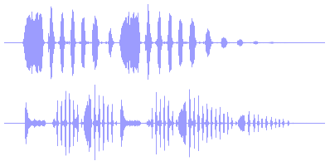
Audio, Voice Data
Speech recognition
Virtual assistants
Biometrics
Speech to text
…
signal1 | signal2
13.58 | 7.24
12.11 | 12.50
13.49 | 8.66
11.25 | 10.98
14.57 | 13.75
13.22 | 9.02
waveform ：one-dimensional array of numbers that represents the sound's amplitude (loudness) over time.

Slide 61
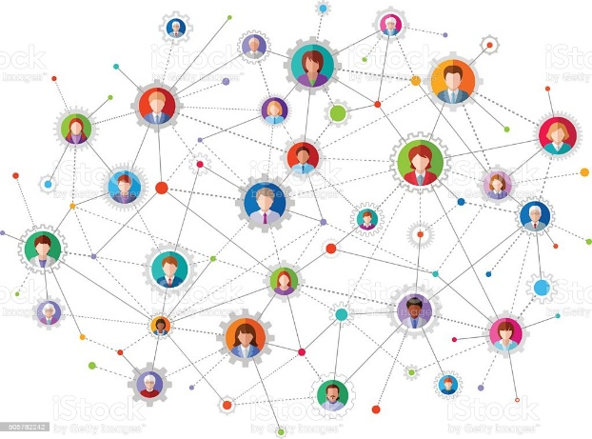
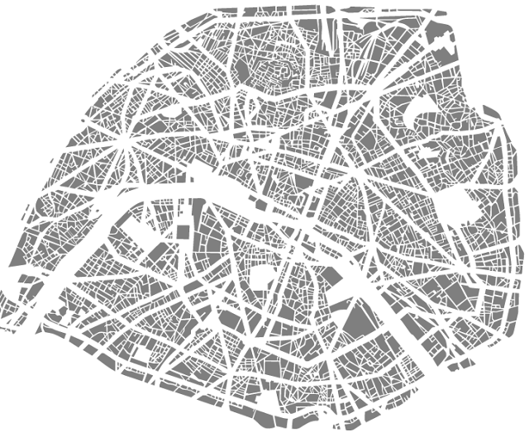
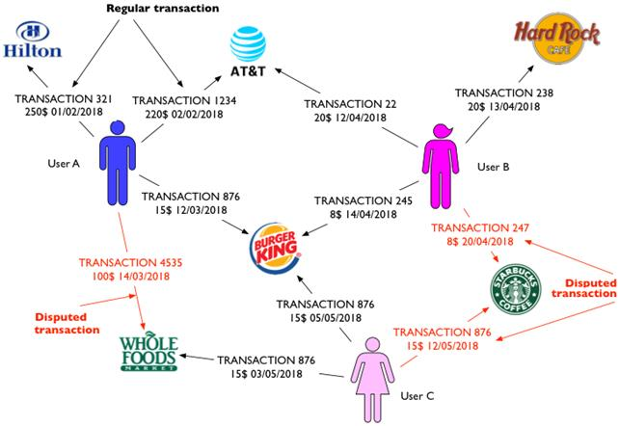
Graph Data
Nodes and edges connecting nodes
Attributes on nodes and edges
Examples:
Social networks
Transportation networks
Transaction networks
…

Slide 62
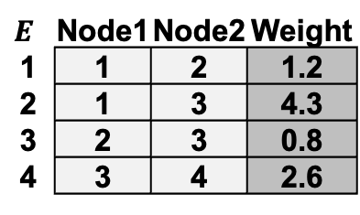
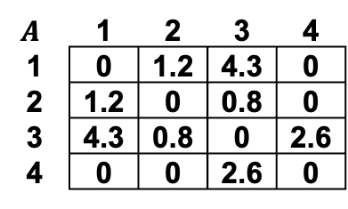
Graph Data
A simple graph example
Nodes and edges
Weights on nodes/edges
Graph representations
Matrix
Edge list
…
1
4.3
1.2
3
2
0.8
2.6
4
$$A$$ | 1 | 2 | 3 | 4
1 | 0 | 1.2 | 4.3 | 0
2 | 1.2 | 0 | 0.8 | 0
3 | 4.3 | 0.8 | 0 | 2.6
4 | 0 | 0 | 2.6 | 0
$$E$$ | Node1 | Node2 | Weight
1 | 1 | 2 | 1.2
2 | 1 | 3 | 4.3
3 | 2 | 3 | 0.8
4 | 3 | 4 | 2.6

Slide 63
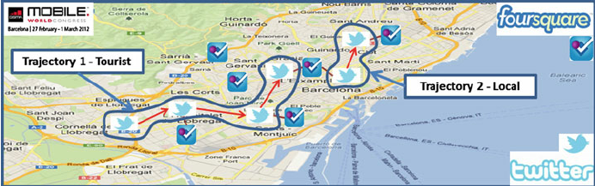
Spatial Temporal Data
Tracking of user’s behavior, commonly collected from location-based service applications
(Local or Tourist?)
Gabrielli, L., et. al., From Tweets to Semantic Trajectories: Mining Anomalous Urban Mobility Patterns, in Citizen in Sensor Networks, 2014

Slide 64
Spatial Temporal Data
Spatial temporal data records both space and time information. It is important for a variety of sciences and disciplines in understanding space-time factors and change.
Temporal data is also called time series.
Spatial observations can be real units or points in space
Observations that are close in time or space are similar
A very popular topic under this subject would be the trend prediction

Slide 65
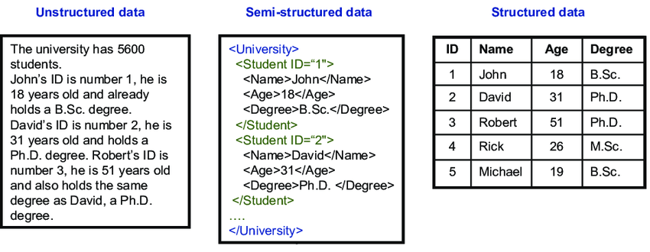
Structured, Unstructured Data
Structured data, typically categorized as quantitative data — is highly organized and easily searchable.
The information contained in the data is easily interpretable by machines
Typically, in a TABULAR format

Slide 66
Structured, Unstructured Data
Unstructured data, typically categorized as qualitative data, does not have a predefined data model and is not recognized in a specific manner.
The information contained in the data is hard to be understood by machines but humans.
Even though unstructured data may have a native, internal structure.
A simple English sentence has a subject, a predicate, and an object.
Difficult to extract data for computer.
Computers need a clear schema to read data.

Slide 67
Structured, Unstructured Data
Main difference: whether it’s easy to be searchable.
In simple terms, if data can be easily sorted and stored in a spreadsheet, it's structured. But if it doesn't fit neatly into a table or a spreadsheet, it's unstructured.
Why are images and videos unstructured?

Slide 68
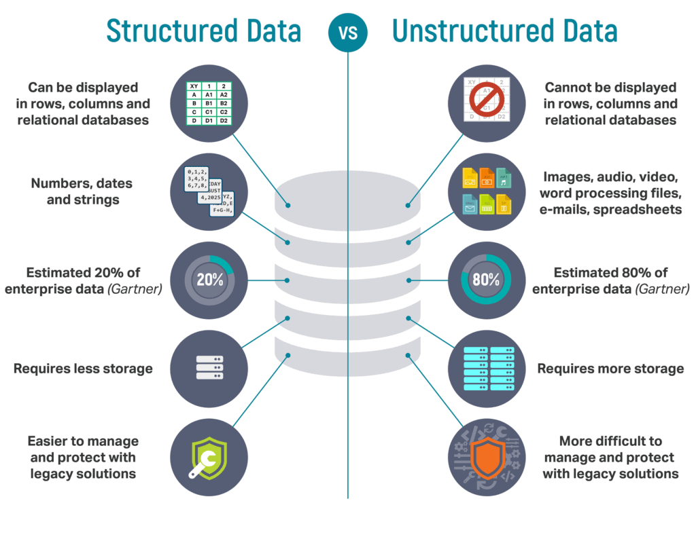
Structured, Unstructured Data

Slide 69
Outlines
Part I: Introduction
- What Drives Big Data
- Characteristics of Big Data
- Technology Towards Big Data
Part II: Basic Big Data Concepts
- Data Concepts/Models
- Big Data Process
- Data Analytics

Slide 70
5-Step Data Analytical Process
Acquire
Prepare
Analyze
Report
Act
Acquire Data
Collect, store, retrieve, query data

Slide 71
5-Step Data Analytical Process
Acquire
Prepare
Analyze
Report
Act
Prepare data (i): exploration
Explore data: preliminary analysis

Slide 72
5-Step Data Analytical Process
Acquire
Prepare
Analyze
Report
Act
Prepare data (ii): data preprocessing
Data integration
Data cleaning
Feature extraction
Feature scaling

Slide 73
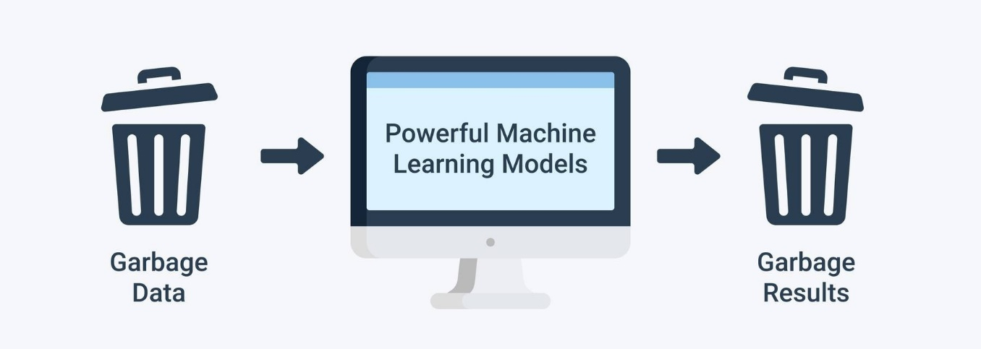
5-Step Data Analytical Process
Acquire
Prepare
Analyze
Report
Act
Data Preprocessing is important.
Why is data preprocessing important?

Slide 74
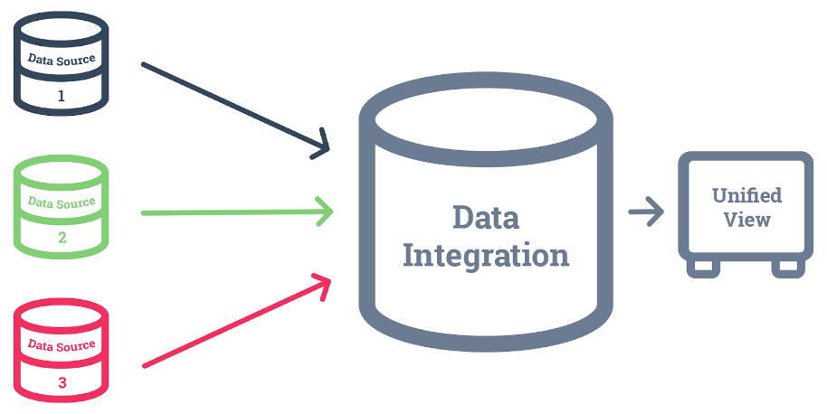
5-Step Data Analytical Process
Acquire
Prepare
Analyze
Report
Act
Prepare data (ii): data preprocessing
Data integration
Data cleaning
Feature extraction
Feature scaling
…

Slide 75
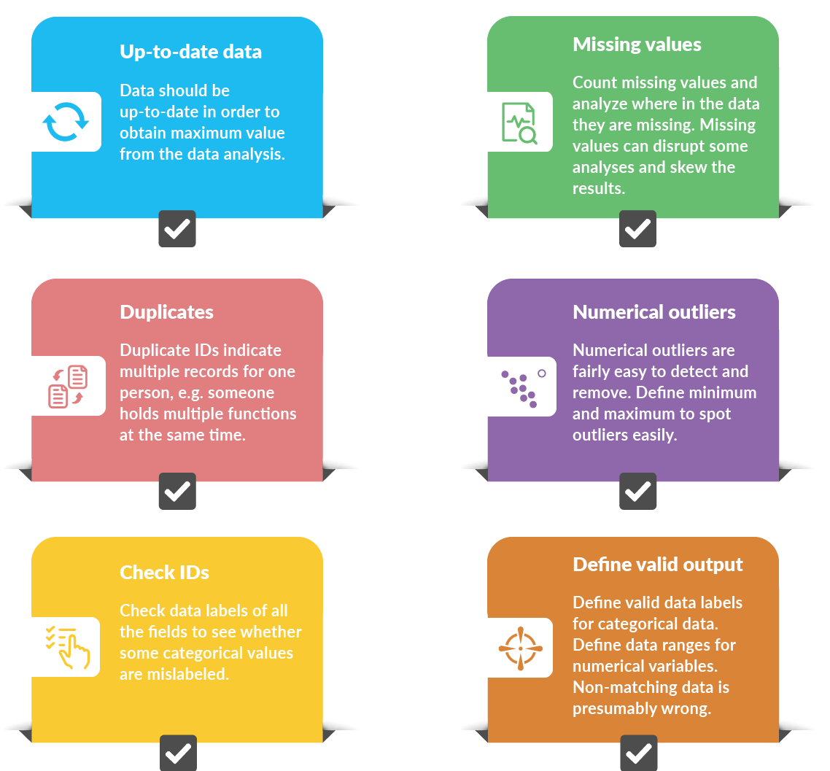
5-Step Data Analytical Process
Acquire
Prepare
Analyze
Report
Act
Prepare data (ii): data preprocessing
Data integration
Data cleaning
Feature extraction
Feature scaling
…
Prepare data (ii): data preprocessing
Data integration
Data cleaning
Feature extraction
Feature scaling

Slide 76

5-Step Data Analytical Process
Acquire
Prepare
Analyze
Report
Act
Prepare data (ii): data preprocessing
Data integration
Data cleaning
Feature extraction
Feature scaling

Slide 77
5-Step Data Analytical Process
Acquire
Prepare
Analyze
Report
Act
Prepare data (ii): data preprocessing
Data integration
Data cleaning
Feature extraction
the process of transforming raw data into numerical features that can be processed while preserving the information in the original data set.
Feature scaling

Slide 78
5-Step Data Analytical Process
Acquire
Prepare
Analyze
Report
Act
Prepare data (ii): data preprocessing
Data integration
Data cleaning
Feature extraction
Feature scaling
Normalization typically means rescaling the values into similar range, e.g., [0,1]

Slide 79

5-Step Data Analytical Process
Acquire
Prepare
Analyze
Report
Act
Prepare data (ii): data preprocessing
Feature scaling (Normalization)
Clipping: Set min/max values to avoid outliers.
scaling to a range
log scaling
z-score
Employee Id | Age | Salary | Salary_ scaled
0 | 35 | 30000 | 0.333
1 | 22 | 20000 | 0
2 | 40 | 50000 | 1
to provide a more meaningful and clear representation of value about its percentage of a range

Slide 80

5-Step Data Analytical Process
Acquire
Prepare
Analyze
Report
Act
Prepare data (ii): data preprocessing
Feature scaling (Normalization)
Clipping: Set min/max values to avoid outliers.
scaling to a range
log scaling
z-score
Employee Id | Age | Salary | Salary_ scaled
0 | 35 | 30000 | 4.477
1 | 22 | 20000 | 4.301
2 | 40 | 50000 | 4.699
to provide a more meaningful and clear representation of data, especially when dealing with data that varies exponentially or over a wide range.

Slide 81


5-Step Data Analytical Process
Acquire
Prepare
Analyze
Report
Act
Prepare data (ii): data preprocessing
Feature scaling (Normalization)
Clipping: Set min/max values to avoid outliers.
scaling to a range
log scaling
z-score
μ is the mean and
σ is the standard deviation
to provide a standardized way of understanding a value's relationship to the mean in a distribution, making it easier to compare different datasets and identify outliers.

Slide 82
5-Step Data Analytical Process
Acquire
Prepare
Analyze
Report
Act
Prepare data (ii): data preprocessing
Feature scaling (Normalization)
Clipping: Set min/max values to avoid outliers.
scaling to a range
log scaling
z-score
μ is the mean and
σ is the standard deviation
to provide a standardized way of understanding a value's relationship to the mean in a distribution, making it easier to compare different datasets and identify outliers.
Employee Id | Age | Salary | Salary_ scaled
0 | 35 | 30000 | -0.21822
1 | 22 | 20000 | -0.87287
2 | 40 | 50000 | 1.091089

Slide 83
5-Step Data Analytical Process
Acquire
Prepare
Analyze
Report
Act
Analyze data
Build models
Select analytical techniques
Clustering
Classification
Regression
Association
…

Slide 84


5-Step Data Analytical Process
Acquire
Prepare
Analyze
Report
Act
Report
Data and result visualization

Slide 85
5-Step Data Analytical Process
Acquire
Prepare
Analyze
Report
Act
Act
Business insights, actions, etc.
Iterative big data process

Slide 86
Big Data Driven Approach (Technical perspective)

Slide 87

Big Data Analytics Pipeline

Slide 88
Outlines
Part I: Introduction
- What Drives Big Data
- Characteristics of Big Data
- Technology Towards Big Data
Part II: Basic Big Data Concepts
- Data Concepts/Models
- Big Data Process
- Data Analytics

Slide 89
Descriptive vs. Predictive
Descriptive Analytics: use data aggregation and data mining to provide insight into the past
Answer: “What has happened?”
Predictive Analytics: use statistical models and forecasting techniques to understand the future
Answer: “What could happen?”

Slide 90
Supervised Learning vs. Unsupervised Learning
Supervised (Predictive)
Classification
Regression
…
Unsupervised (Descriptive)
Clustering
Association
…

Slide 91

Supervised Learning vs. Unsupervised Learning
Supervised
Unsupervised
B
It is Yellow
R
Y
Y
Model
Model
…
…
(68, 144, 196)
I can see difference
B
Y
(255, 192, 0)
Labeled Data
Direct Feedback
Predict Output
Non-labeled Data
No Feedback
Find Hidden Structure in Data

Slide 92
A General Supervised Approach
Data set
Training Set
Optimize
Parameters
Algorithm
Model
Test Set
Evaluate

Slide 93

Supervised Learning
Regression
Learning to predict a continuous/real value
e.g.: housing price, gold price, stock price

Slide 94

Supervised Learning
Classification
Learning to predict a discrete value from a predefined set of values (i.e., predicts categorical class labels)
e.g., weather prediction, spam email filtering, product categorization, object detection, medical diagnose

Slide 95

Unsupervised Learning
Clustering
Determine the intrinsic grouping in a set of unlabeled data
e.g., clustering in networking, image clustering

